Slide 1
CSE 6324 Advanced Topics in Software Engineering
By Team 8:
SAI NIKHIL KANCHUKATLA(1002034488)
SAMPATH KUMAR MEDIPUDI(1002032901)
SAI KRISHNAM RAJU BHUPATHIRAJU(1002019782)
FARAZ SHAIK AHMAR(1002035224)

Slide 2
Outline
Project Plan
Specification and Design
Use Case Diagram
Issue and code
Risks and solutions
Customer and Users
References

Slide 3
Project plan
Iterations | Goals | Achieved Goals
1 | To gain a deeper understanding of the slither tool, we perform analysis on example smart contracts, providing a practical experience and familiarization with the tool. Set up and configure the slither tool in order to reproduce an identical error message. Evaluate the issue more comprehensively and devise a plan to address and resolve it. | completed
2 | Examine the "missing-zero-check" detector, comprehend all its attributes, and grasp its operational flow. Develop pseudo code that will facilitate the implementation of the improvements we aim to introduce to the slither tool. | In-progress
3 | Translate the pseudo code into real code and evaluate the tool to determine if any new vulnerabilities arise after modifying the existing tool. Verify the effectiveness of the improvements made to the tool by testing it on smart contracts. | Yet to start­­­­

Slide 4
Specification and Design
Input : Smart contract
Output : The analysis findings from conducting test cases.

Slide 5
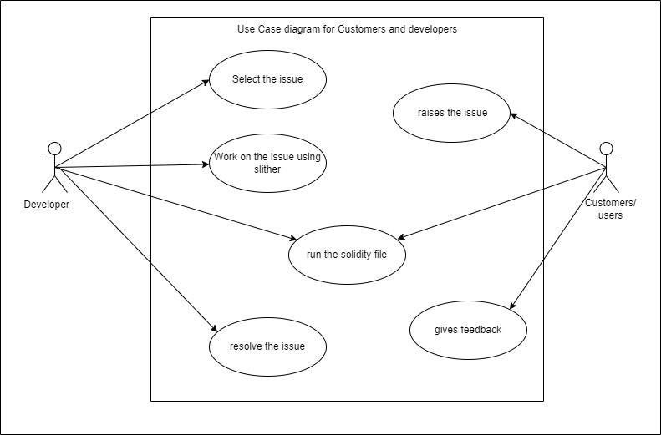
USECASE

Slide 6
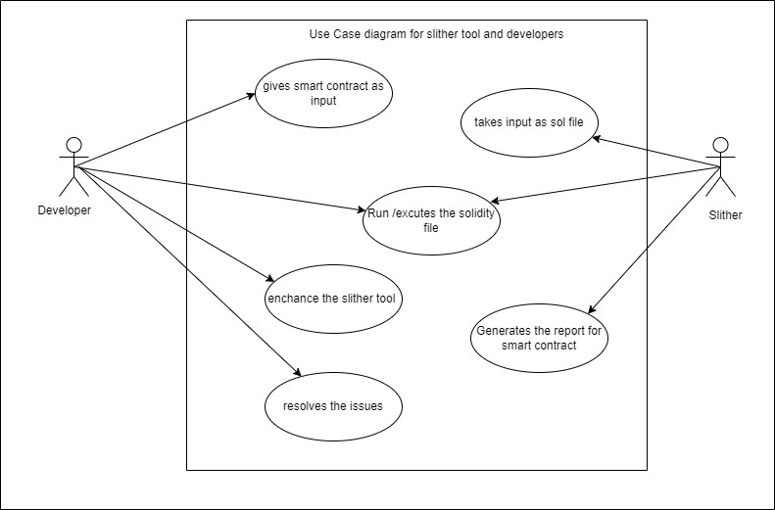

Slide 7
Issue #981:
“missing-zero-check” detector doesn't seem to check the arguments for constructor of parent contracts. Even if the parent contract's constructor has zero-access checks & the child contract is using the same variable, it's gets flagged. [8]
Copy-paste from github[8]

Slide 8
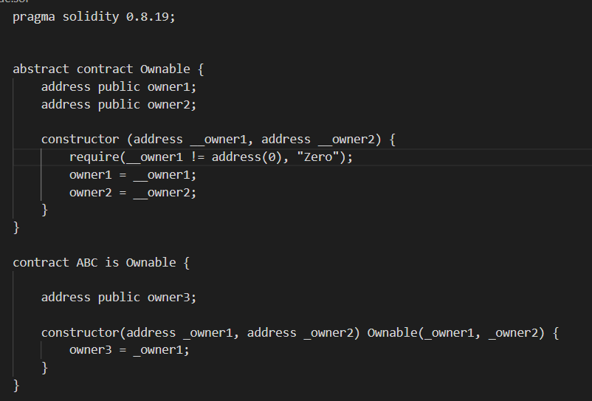
Code:
Figure [https://github.com/crytic/slither/issues/981]

Slide 9
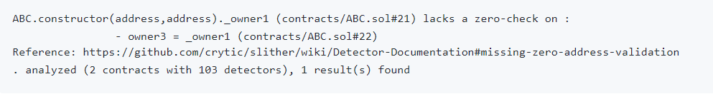
Output
Figure [https://github.com/crytic/slither/issues/981]

Slide 10
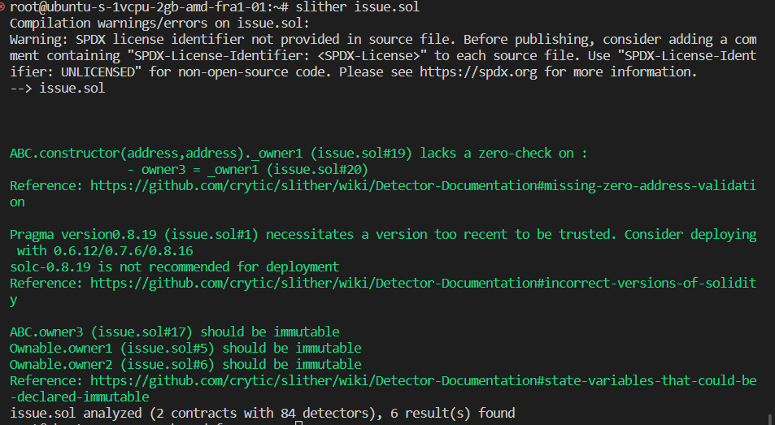

Slide 11
Risks AND SOLUTIONS
Risks | Major/Minor | Solution | Current Status
Installation of Slither (Configuration and setup) | Major risk P = 20% and E = 20 , so extra 4 hrs | For new users to reduce this risk, it's crucial that they thoroughly read the Slither team's documentation. | Completed
Unfamiliarity with the tool | Minor risk P = 30% and E = 10, so extra 3 hrs | It's crucial for new users to read the material given by the Slither team in order to lower this risk and watch the handson videos on youtube. | Completed
Installation of dependencies(Python) | Minor risk P = 15% and E = 10, so extra 1.5 hrs | Users face difficult in setting up compatable version of python to run slither. | Completed

Slide 12
Risks AND SOLUTIONS
Risks | Major/Minor | Solution | Current Status
Failure to meet iteration targets | Major risk P = 30% and E = 15 , so extra 4.5 hrs | The idea is to divide the work evenly and work together in a group meeting following each session or on weekends. | In progress
Logic failure | Major risk P = 30% and E = 20, so extra 6 hrs | The danger can be mitigated by thoroughly testing and debugging the code. | In progress

Slide 13
Customer and Users
Block chain Developers
Block chain organizations
Researchers
Security Researchers

Slide 14
Github link
https://github.com/Sampath2901/6324-Project#6324-project

Slide 15

References
[1] https://www.visual-paradigm.com/guide/uml-unified-modeling-language/what-is-use-case-diagram/
[2] https://doi.org/10.48550/arXiv.1908.09878
[3] https://doi.org/10.48550/arXiv.1809.02702
[4] https://github.com/crytic/slither
[5] https://blog.trailofbits.com/2018/10/19/slither-a-solidity-static-analysis-framework/
[6] https://medium.com/coinmonks/automated-smart-contract-security-review-with-slither-1834e9613b01
[7] https://www.linkedin.com/pulse/how-secure-smart-contracts-slither-damilare-d-fagbemi/?trk=pulse-article_more-articles_related-content-card
[8] https://github.com/crytic/slither/issues/981
[9] https://app.diagrams.net/

Slide 16

Thank You

